Slide 1
Introduction to AI, fairness and bias
The pictures in these slides were generated using ChatGTP, AI Art and Canva

Slide 2
AI - Introduction
Notes:
This section (or parts of it) can be used as an introduction or recap of basic concepts regarding AI and classification algorithms.

Slide 3
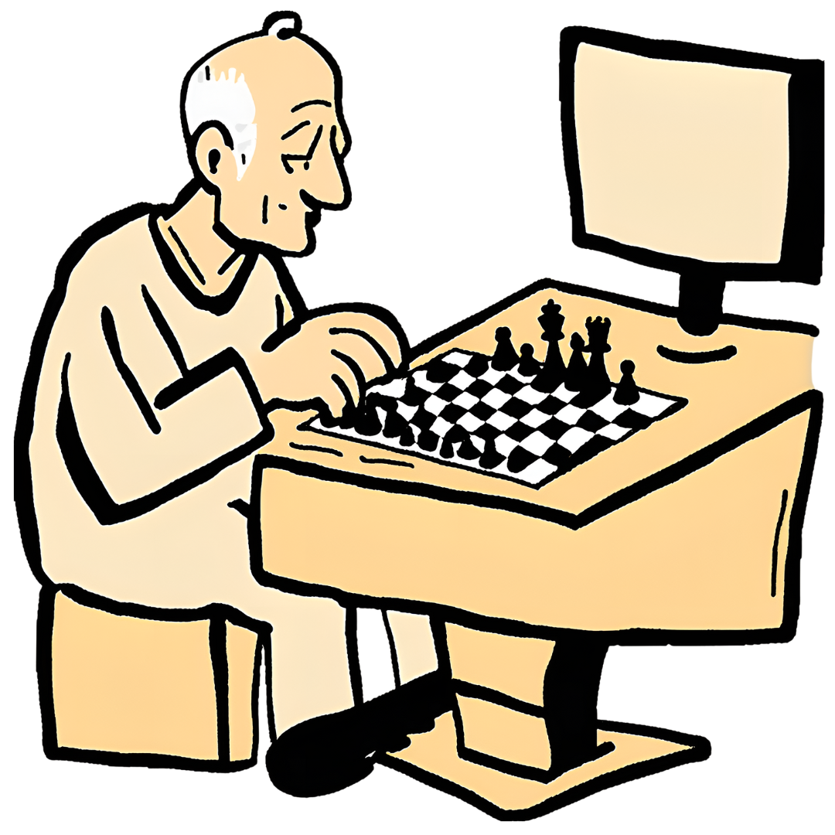
Artificial Intelligence around us
Artificial Intelligence refers to technological applications designed to simulate intelligence, such as the ability to learn, take decisions, and interact with surrounding environments
AI applications around us include:
Recommendation Systems (YouTube, Instagram…)
Virtual Assistants (Alexa, Siri…)
Generative algorithms (ChatGPT, Dall-E…)
Autonomous vehicles
Playing agents (Chess, Go, various videogames…)
Did you know that the best chess player in the world is a computer program called Stockfish? Its rating (a measure of chess proficiency) is more than 3600. The best ever human player’s rating is less than 2900.
Notes:
Use this slide to introduce AI common applications and benefits

Slide 4
A real scenario
In 2014, a team at Amazon started working on an algorithm that would automatically rank candidates for hiring
Advantage: Amazon receives a lot of applications and it has an interest in identifying the best candidates quickly and effectively
But…
source: https://www.reuters.com/article/us-amazon-com-jobs-automation-insight-idUSKCN1MK08G/
Notes:
This slide is meant to generate doubt → AI applications can cause harm or not work as intended
Story: the algorithm was trained to analyze resumes; it was trained on the last 10 years of actual applications and hiring data; for tech positions, the algorithm learned that men were preferable, since most applicants and hires were men; it started ruling out women by looking for keywords in their resume, like “women’s chess team captain”; after some attempts to fix this, the project was abandoned in 2017.
Alternative source: https://globalnews.ca/news/4532172/amazon-jobs-ai-bias/

Slide 5
AI under scrutiny
Today, there is a call for increased attention toward responsible use of AI applications, including a focus on aspects such as:
Fairness = the idea that outcomes of an AI application must be equitable, i.e. no group should be discriminated against/receive a different treatment
Accountability = clearly identify people responsible for the outcomes and derived consequences
Transparency = the ability to explain outcomes and decisions, as well as transparency in data acquisition and provenance

Slide 6
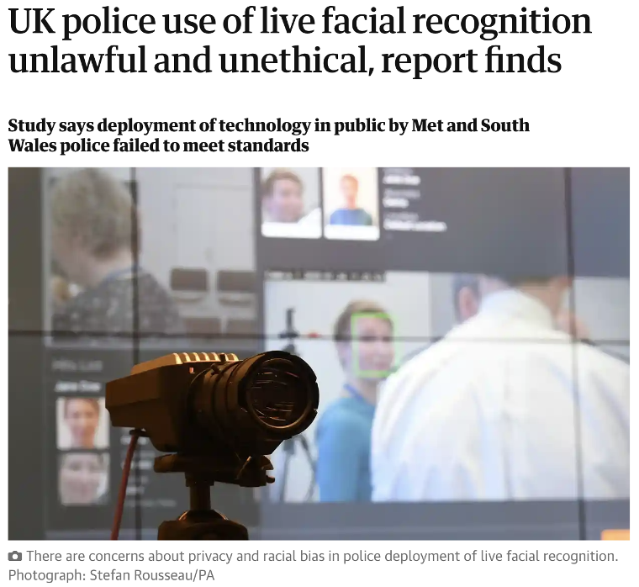
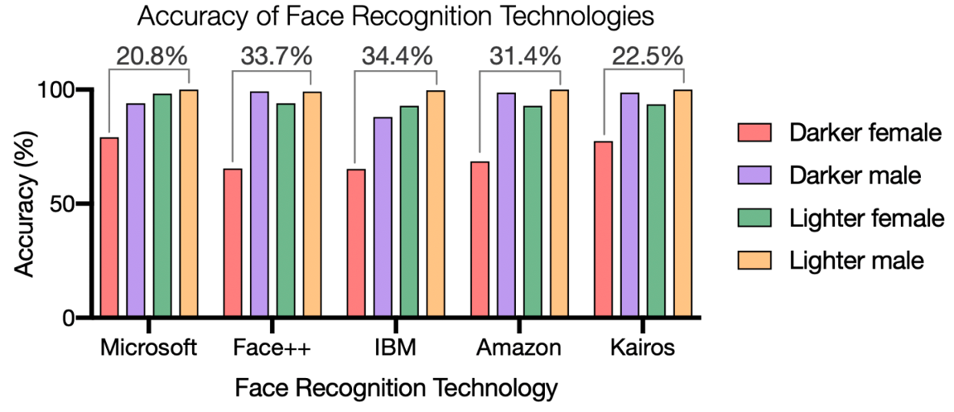
More examples: fairness
source: https://sitn.hms.harvard.edu/flash/2020/racial-discrimination-in-face-recognition-technology/
Source: https://www.theguardian.com/technology/2022/oct/27/live-facial-recognition-police-study-uk
Notes:
Story: human right activists in the UK are fighting against the use of Live Face Recognition (LFR), which the police hopes to use to fight crime and terrorism. The activists argue that this technology, on top of being an important invasion of privacy, was not reliable, with an accuracy of just 20%. Furthermore, for low level of confidence, the system was found to be biased against black people (i.e. when uncertain, it would flag a black person more frequently than a white or Asian one; source: https://www.theregister.com/2023/05/25/facial_recognition_system_used_by/).
Racial bias in face recognition algorithms is common, therefore applications must be chosen and monitored carefully.
Important note: face recognition algorithms are not unfair just for failing to recognize a black person, they are unfair because they do so at higher frequency than white people.

Slide 7
More examples: accountability
When technologies are involved, it is more difficult to pinpoint who is responsible when accidents happen.
This is a legislative gap. Unfortunately, technology move at a much faster pace than the law, so these episodes are not infrequent.
source: https://arstechnica.com/cars/2019/05/feds-autopilot-was-active-during-deadly-march-tesla-crash/
Notes:
Read and discuss story: https://arstechnica.com/cars/2019/05/feds-autopilot-was-active-during-deadly-march-tesla-crash/
Highlights: all parties involved had some level of responsibility. Tesla, because the algorithm failed to recognize the incoming truck; the driver, because he was using the autopilot in a non-recommended way and without paying attention; the truck driver, because they did a questionable maneuver to merge onto the highway.

Slide 8
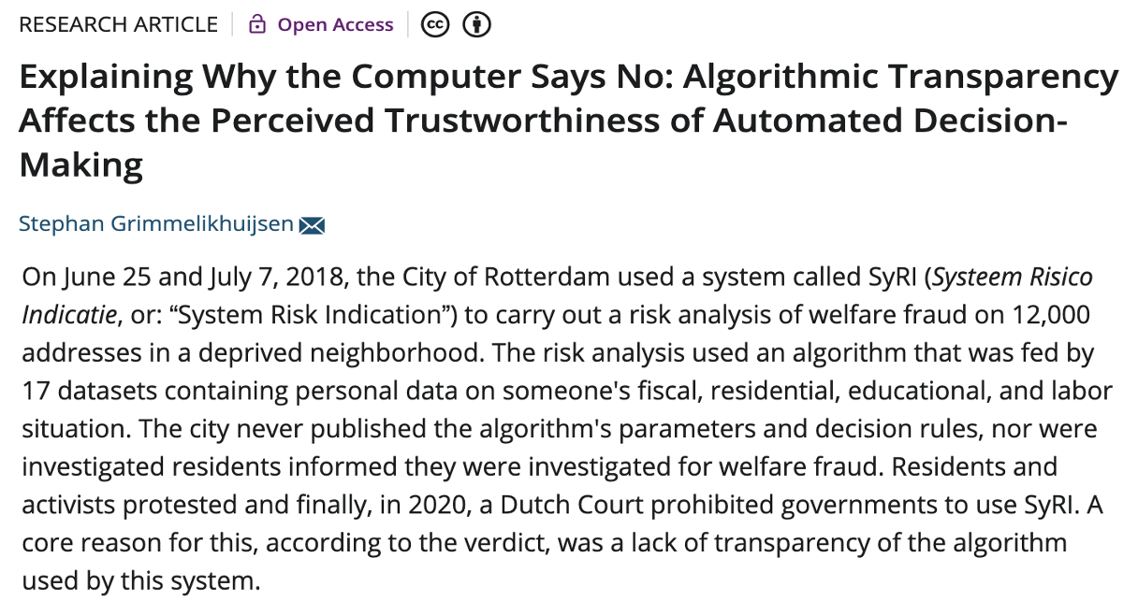
The issue of transparency
source: https://onlinelibrary.wiley.com/doi/full/10.1111/puar.13483
Notes:
Source (read): https://digitalfreedomfund.org/the-syri-victory-holding-government-profiling-to-account/
https://onlinelibrary.wiley.com/doi/full/10.1111/puar.13483
Issues (in order of highlight):
The algorithm and the way it operates are not public; people do not know why they have been classified a certain way
Often, they did not even know the algorithm was being used to classify them
It is also unclear if the data used to train the algorithm had this purpose disclosed to the owners

Slide 9
AI and the environment
We have talked about how AI applications are becoming ubiquitous in society. Few people, however, including few of the developers of these systems, spend time thinking about their environmental impact. Even fewer try to evaluate this impact.
The environmental cost of training and maintaining AI algorithms is not immediately evident, but it includes:
The massive amount of electricity required.
Depending on how that electricity is produced, there is also a variable cost in terms of CO2 released in the atmosphere.
The cost of building and maintaining the hardware on which AI algorithms run.
Recent estimates of AI’s carbon footprint range from 2.1% to 3.9% of the total greenhouse gas emissions. Still a small fraction of what is produced by more polluting industries such as manufacturing (24%) and transportation (27%), but not insignificant.
Source: The Carbon Footprint of Artificial Intelligence

Slide 10
Accuracy-Efficiency Paradox
“There is a recognised trade-off between model accuracy and energy efficiency. In fact, the relationship has been shown to be logarithmic. That is, in order to achieve a linear improvement in accuracy, an exponentially larger model is required. A recent study [...] confirmed the existence of the accuracy-energy trade off [...] and indicated a 30-50% saving in energy for training related to a 1% reduction in accuracy.”
Mill et al., Managing Sustainability Tensions in Artificial Intelligence: Insights from Paradox Theory
Notes:
Reflection question for the audience: is it always worth it to increase the energy demand by 30-50% for a 1% improvement in accuracy?

Slide 11
Strategies for Greener AI
Optimizing AI algorithms to improve energy efficiency and reduce computational demands.
Transitioning to renewable energy sources for data centers and AI infrastructure.
Exploring more sustainable hardware solutions designed for energy efficiency and reduced environmental impact.
Notes:
We have seen that AI can contribute to carbon footprints. However, there is an increasing need for data centers as we live in the age of AI and data-driven technologies. Are there data centers in our country? What are the strategies to ensure these data centers do not significantly increase carbon emissions?

Slide 12
Data Bias
Notes:
In this section, we will talk in detail about fairness issues with AI applications, bias and its sources, and how to measure fairness. Students will need to understand basic performance metrics (accuracy, how to read a confusion matrix) and the idea of algorithm training (via examples)

Slide 13
Bias in data
AI algorithms learn through the examples they are provided with, which together form what we call the training set.
Bias in the training set will affect the algorithm’s behavior, likely amplifying existing problems and mistakes.
Let’s explore a few ways in which a training set can be biased.

Slide 14
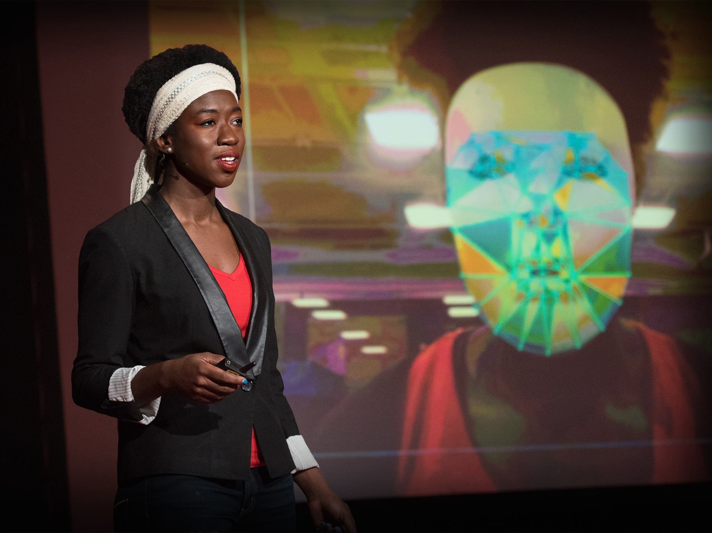
Representation bias
Representation bias happens when the training set is, essentially, incomplete, and a poor representation of the population we wish to apply the algorithm on.
Other times, representation bias happens when trying to use existing samples from a different time or place, instead of collecting new ones.
Dr. Joy Buolamwini demonstrating failures in face recognition.
Notes:
A famous example of representation bias was reported by Dr. Buolamwini, when she realized that most commercially available face recognition algorithms could not recognize her dark-skinned face. This happened because the algorithm was mostly trained on a sample of white, male individuals, and performed much worse when seeing other faces.

Slide 15
Measurement bias
Measurement bias has to do with the way we try to create a numerical representation of the problem that we are trying to solve. It may arise in a couple of different ways, such as:
The features or labels used are an oversimplification of the problem
Different groups are measured in different ways
Notes:
The features or labels used are an oversimplification of the problem. For example, when universities decide which students to admit, they try to assess students’ intelligence, to admit those more likely to succeed. But since intelligence can not be measured, they use proxies instead - GPA, entry exam scores - which can be affected by a lot of factors (like a very smart student getting anxious on the day of the entry test).
Different groups are measured in different ways. For example, if more police is deployed to patrol a particular neighborhood, they may find more crimes and incorrectly deduce that this neighborhood is more dangerous than others, while in fact they are just being able to capture more cases.

Slide 16
Historical bias
Historical bias refers to a misalignment between what we wish to model and the actual state of the world.
The Amazon AI recruiting tool discussed earlier was affected by historical bias. The algorithm was trained to select people similar to the existent employees, and because men employees were more numerous than women, the algorithm learned that, all things being equal, women were less preferable candidates.
Note that historical bias is particularly insidious, because it is not a sampling or measurement problem, and can not be corrected in the training set – we can only work around it.

Slide 17
Learning Algorithms - Fundamentals
Notes:
This section is designed to introduce basic machine learning concepts to a completely novice audience. If working with students already familiar with training/testing, accuracy, and confusion matrices, you may skip this section.
Introduction (to connect to previous section): let’s learn a bit more about the way algorithms are trained, to understand how a biased data set influences a learning algorithm.

Slide 18
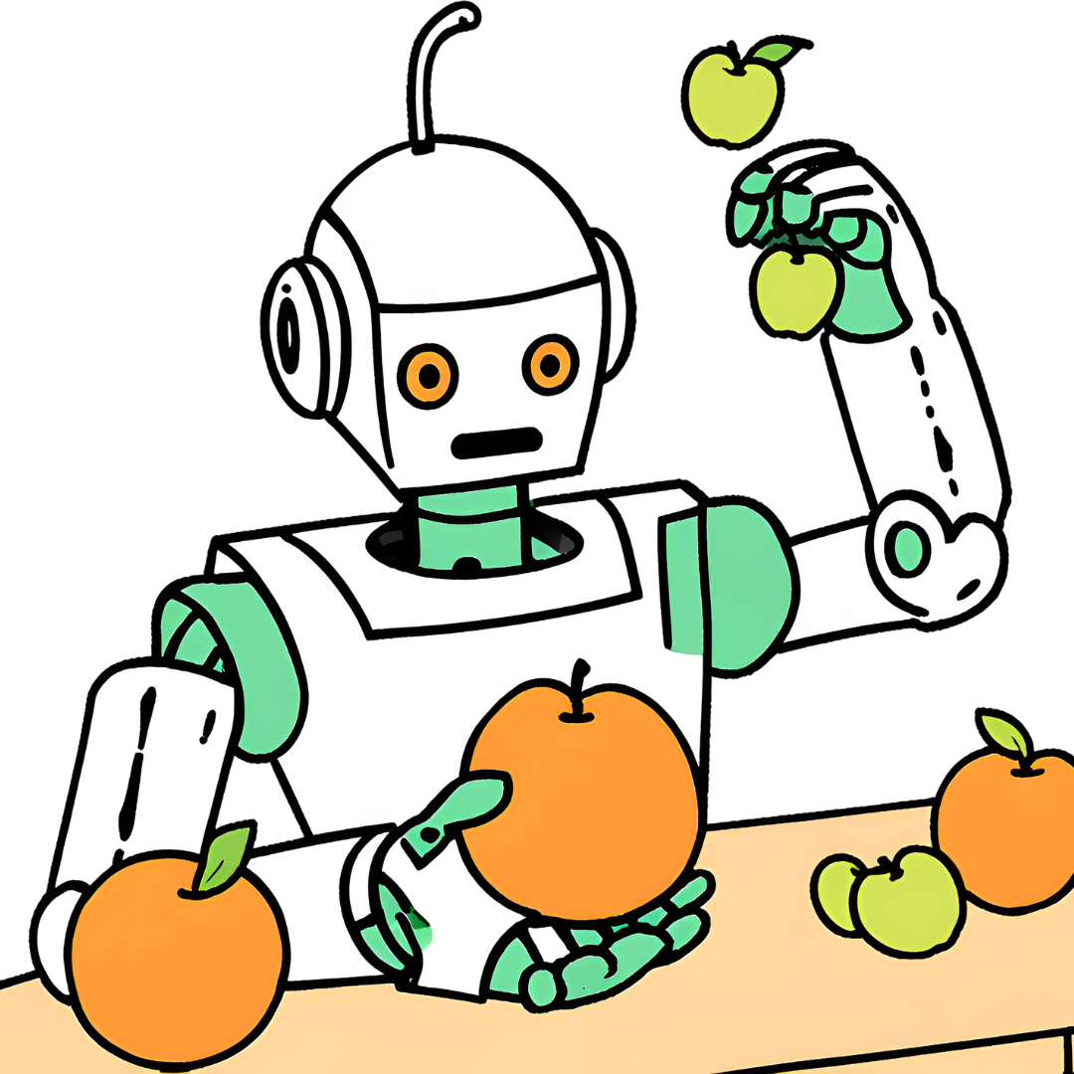
A shift in paradigm
AI is becoming increasingly powerful, thanks to a fundamental shift in the way it is programmed. Imagine wanting to program a machine to recognize and separate apples and oranges:
Traditionally, a programmer would need to write code including rules to follow to separate apples from oranges based on their characteristics (e.g. color, skin texture, shape…). It was typically hard to come up with a good set of rules, especially for complex problems!
With recent AI approaches (e.g. neural networks), we see many programs written to learn rather than to follow existing instructions. This way, all one has to do is showing the machine enough apples and oranges, and it will learn how to recognize new samples!

Slide 19
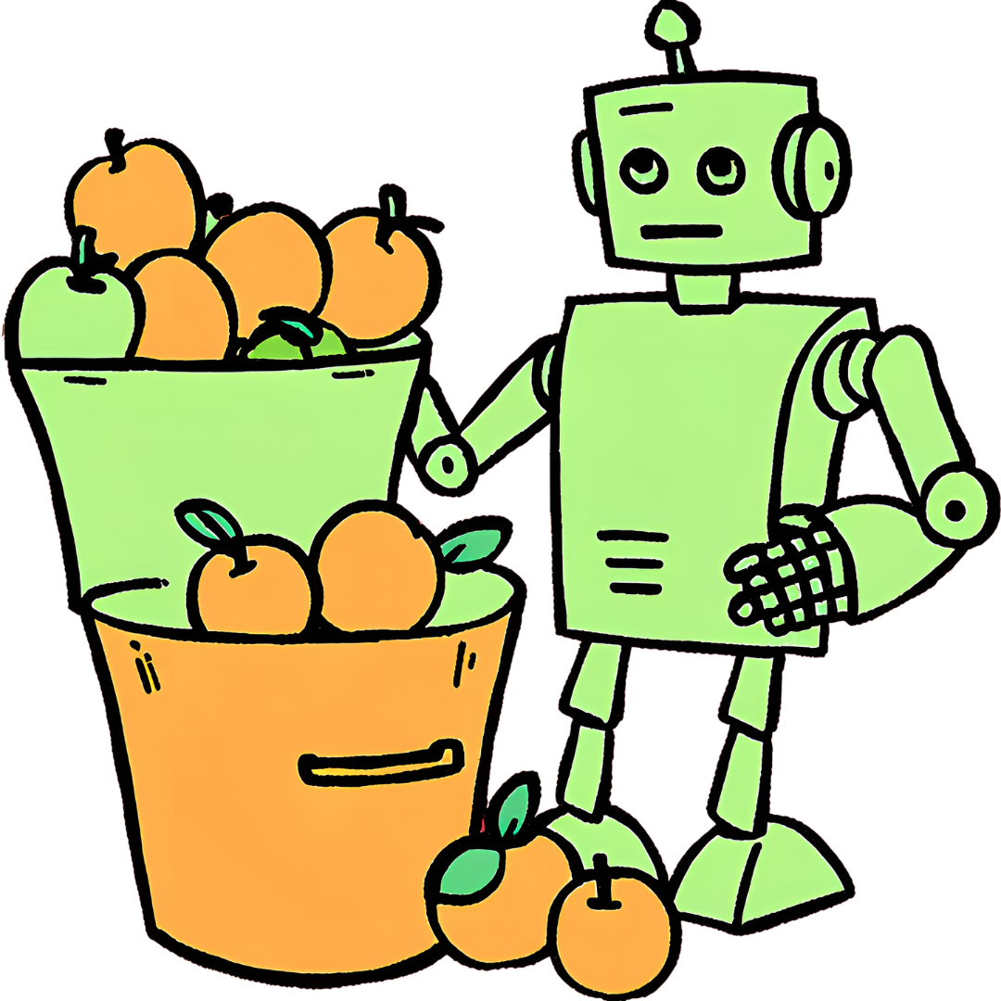
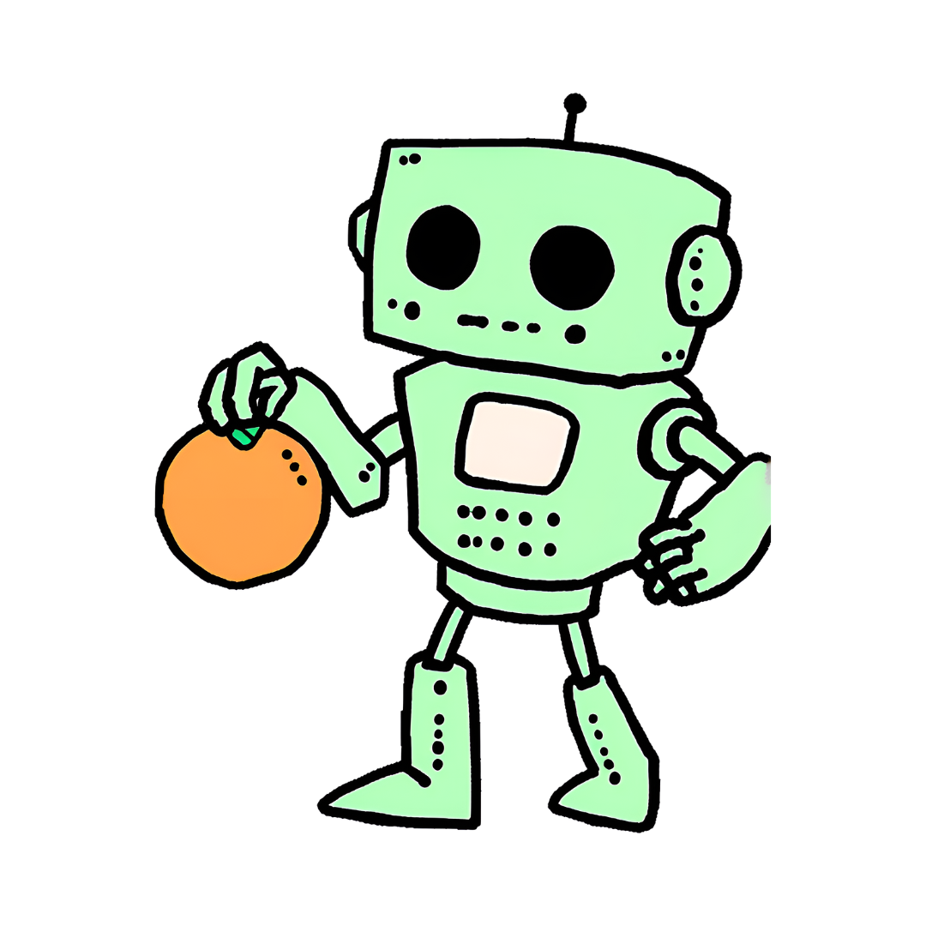
How does a program learn?
TRAINING
DEPLOYMENT
Labeled samples
This is an orange!
Notes:
Learning algorithms can be very different from each other in the way they learn and represent solutions to the problem they have been assigned to solve, but, for the most part, they all achieve their goal by recognizing errors and trying to minimize them.
In our apples/oranges example, when the machine is learning, it is given examples with a known label (which ones are apples and which ones are oranges), and tries to formulate the best set of rules to separate them, so that the smallest number of fruit ends up in the wrong bucket.
This is a classification problem: the algorithm is trying to assign a sample to a predefined class.

Slide 20
Measuring performance
A computer needs a quantitative metric to measure how well they are performing their task. The most common performance metric is called accuracy.
Accuracy simply counts how many samples were classified correctly.
The chart to the left (called a confusion matrix) shows how the machine classified 50 apples and 50 oranges.
Accuracy = 45 + 43 /100 = 0.88, or 88%
45
5
7
43
Notes:
45 apples and 43 oranges were put in the right bucket, while 5 apples and 7 oranges were classified incorrectly.

Slide 21
Your turn!
Try to evaluate the accuracy of this machine, based on this new confusion matrix:
50
0
12
38
Notes:
Accuracy is 88% in this example too

Slide 22
When accuracy is not enough
In both examples the resulting accuracy was 88%.
The first case was more balanced, while in the second example more fruits were misclassified as apples.
If the error’s cost is symmetric (it is just as bad to classify an apple as an orange than vice-versa), then both machines are equivalent. But in some cases this is not true.
Can you think of real applications in which making an error in a direction is worse than making it in the other?
Notes:
The previous example shows us something very interesting! Although the errors made were different, the accuracy in both cases was 88%. The first case was more balanced, while in the second example the machine tend to make more errors in the “apple” direction, and placed 12 oranges in the apples bucket.

Slide 23
Examples of not symmetric error cost
When it’s better to be more careful
In most medical applications it is better to classify a few more patients as having the disease, then follow up.
When it’s better to let it slide
In the case of a spam filter (yes, that’s AI too), it may be better to classify emails as legitimate, rather than losing possibly important, legitimate emails.
Notes:
In most medical applications (e.g. an algorithm trying to identify a tumor in a brain image), it is better to classify a few more patients as having the disease. This may give them a scare, but it can be clarified with further tests. Classifying a sick patient as healthy can be very dangerous and result in missing important treatment.

Slide 24
Confusion matrix – a closer look
Let’s take a closer look to the confusion matrix – this will help us define other performance metrics.
Typically, in a classification problem, we define a class of interest (positive class) that we want to separate from the other (negative class). Based on our choice, we can label the cells of the confusion matrix as shown in the picture
True Positive
(TP)
False Negative
(FN)
False Positive
(FP)
True Negative
(TN)

Slide 25
Other performance metrics
True Positive
(TP)
False Negative
(FN)
False Positive
(FP)
True Negative
(TN)
Notes:
Worth mentioning that other performance metrics exist, and these are just examples of alternatives to accuracy

Slide 26
Exercise
We already know the accuracy of these two algorithms is 0.88. Now, compute their recall and precision.
45
5
50
0
7
43
12
38
Notes:
Left:
Recall = 45 / (45 + 5) = 0.9 = 90%
Precision = 45 / (45 + 7) = 0.86 = 86%
Right:
Recall = 50 / (50 + 0) = 1 = 100%
Precision = 50 / (50 + 12) = 0.81 = 81%

Slide 27
Choosing the right metric
Based on the application, we may want our algorithm to optimize for a metric rather than others.
Understanding questions:
In a medical application, where it is really important to not miss patients with a disease, what metric should we optimize: accuracy, recall or precision?
What about in the spam filter example?
Can you think of an easy way for an algorithm to have perfect recall? Do you think this algorithm would be actually useful in the real world?
Notes:
Recall is more important, because as we said we would not want to miss sick patients; obviously, it needs to be balanced to not have too many false positive
Precision is better in this case - only send email to spam if it is reasonably sure that they are spam
Classifying all samples as positive would give perfect recall! Obviously, this algorithm is useless…

Slide 28
Recap
In this section, we have learned:
Sample applications of AI
Difference between learning algorithms and traditional programming
Performance metrics for simple classification tasks: accuracy, recall and precision
How to read a confusion matrix

Slide 29
Fairness and AI
Notes:
In this section, we will talk in detail about fairness issues with AI applications, bias and its sources, and how to measure fairness. Students will need to understand basic performance metrics (accuracy, how to read a confusion matrix) and the idea of algorithm training (via examples)

Slide 30
Unfairness in learning algorithms
Scenario: The Data Science University has decided to use an admission test to select which of the students who apply should be admitted. The top N students get in, the others are rejected.
In this world, two races exists: Circles and Squares
Circles tend to be wealthier; this means their families can pay tutors and preparation centers to help them ace the admission test.
Other than this difference in preparation, the two populations are equally likely to succeed.
-
-
+
-
+
+
-
-
+
-
+
+
-
-
-
+
+
+
+
-
+
+
+
+
Admission test scores
More fair
Optimal
Example based on “The ethical algorithm”, by Kearns and Roth
Notes:
This graph shows the students placement in the admission test. The +/- symbols indicate students who will complete the degree (+) and those who will not (-).
The university’s goal is to minimize the number of errors (students admitted who do not graduate and students rejected that would have succeeded). Based on this population, where would you place the entry cut-off to maximize accuracy? Does that look fair?
Notice that Circles are the majority and will skew the cutoff
Optimal: 7 mistakes, 70.8% accuracy, but only 1 false negative for Circles, 5 for Squares
More fair: 8 mistakes, 1 false negative for Circles, 3 for Squares
Focusing on accuracy can give a false sense of being “right”, while ignoring the fact that errors are affecting one group more than another.

Slide 31
Social impact of AI
The previous example shows how AI applications can end up being biased, and treat different populations differently.
Note that this often happens involuntarily: the algorithm was not trained to be unfair to a group, it has simply learned based on the examples it was shown.
In complex problems, it is difficult to achieve a good representation of the information we are trying to classify, and we are likely dealing with a lot of noise. Coming up with a good algorithm is challenging, and the consequences for real people can be severe.
Notes:
Question for the audience: What kind of bias are we dealing with in this example?
Answer: historical bias

Slide 32
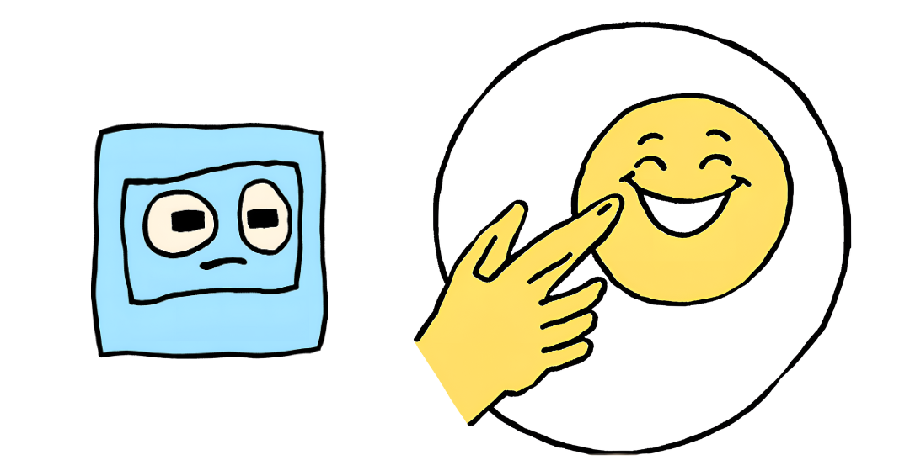
Other kinds of bias - algorithmic bias
A biased dataset will most likely produce a biased algorithm.
We talk about algorithmic bias^{(*)} when an algorithm systematically and unfairly favors a group over others, in a way that has nothing to do with the original intention of the algorithm.
In our example about university admissions, the goal was to admit the best students, but the algorithm is biased against Squares for reasons other than their academic abilities.
^{(*)}Note that, in Machine Learning, we also talk about “high bias” in an algorithm when the algorithm is too simple and inflexible to capture the trend in the data.

Slide 33
Other kinds of bias - evaluation bias
After training, a classification algorithm must be tested on a different set of data, to measure its performance on samples it has not seen before.
If the testing set is biased in a similar way as the training set, we will remain unaware of possible issue with fairness. We may also report incorrect, overly-confident measure of performance, and deploy an algorithm that will end up failing when used in the real world.
To avoid evaluation bias, it is important that the algorithm is tested on a dataset that well represents the population it will be used by (or on).

Slide 34
Why does this matter?
Learning algorithms are becoming increasingly popular and their application widespread, because they are:
Cheap
Scalable
Automated
Unfortunately, they are also:
Seemingly objective - for years, the idea of bias in algorithms was rejected, because it was thought that, because machines do not have emotions, they could not be sexist, racist, etc…
Often lacking appeals processes, because the responsibility of a wrong prediction is difficult to assign (is it the programmer’s fault? Or the client’s?)
Not just predicting but also causing the future – decision algorithms can significantly influence the world on which future algorithms will be based, creating a vicious cycle.

Slide 35
Measuring fairness
As seen before, high accuracy does not guarantee fairness
Other metrics can be used to measure fairness of an algorithm, for example:
statistical parity: whether the rates of positive predictions are on par across groups
equal opportunity: whether the ratios of false positives to predicted positives are on par across groups
predictive equality: whether the ratios of false negatives to predicted negatives are on par across groups
-
-
+
-
+
+
-
-
+
-
+
+
-
-
-
+
+
+
+
-
+
+
+
+
Admission test scores
Highest accuracy
Notes:
Unlike accuracy, fairness has many mathematical definitions.
They all try to balance outcomes across protected groups.
You must choose the right one(s) for the application.
There are actually more (you can read this paper by Verma and Rubin for an overview)
In the attached worksheet, students will work from the definition to a formula for each fairness metric (that is why they are not given here)

Slide 36
Data Ownership in the Age of AI
Notes:
Connect from previous slide mention about dataset unclear provenance.

Slide 37
Data ownership in AI age: Why does it matter?
We live in an age where data fuels innovation; data is the backbone of AI and machine learning algorithms
Understanding data ownership goes beyond legal matters; decisions made from data and AI based algorithms are expected to have the broader societal and ethical implications.
Companies with ownership of high-quality data are better positioned to unlock domain specific insights increasing their chances for innovations, monetizing the models and expanding competitive advantage.
Notes:
It is important to understand that without data, there are no AI models. AI models entirely depend on massive amounts of data for training. The effectiveness of AI models is directly related to the quality of the data used in their training. AI systems are created to solve problems in areas such as health and education, which affect various social and cultural contexts. For example, if the data used to determine the probability of college completion in a certain country favors students from high-income families, AI models consuming this data are likely to favor this group, which may not reflect reality and could further widen the social bias against students from underprivileged families.

Slide 38
What is data ownership?
Data ownership determines who has the legal rights to control, access, and use data.
As such, data ownership deals with the issues of intellectual property, and the roles of various stakeholders, including individuals, organizations, and governments and regulatory bodies.
Notes:
You have seen that data ownership is multifaceted, involving diverse stakeholders such as individuals, organizations, governments, and legal entities. The level of participation and interaction with the data may vary. Therefore, it is important to define ownership at different levels, from the individuals whose data is collected to the institutions utilizing the data, such as AI companies and hospitals. For example, consider data collected from cancer patients in a certain region. This data contains private and sensitive information. As a result, it is expected to be used with a high level of accountability and confidentiality. For instance, who takes ownership if the data is accessed by unauthorized people? Understanding these complexities is crucial for navigating the ethical and legal implications of AI development.

Slide 39
Scenario
Question: How can AI companies develop models that respect data ownership while still advancing innovation? https://www.reuters.com/legal/getty-images-lawsuit-says-stability-ai-misused-photos-train-ai-2023-02-06/
Notes:
We saw earlier that AI models are data-hungry, and there is always a need for massive amounts of data to train the models efficiently. This case study clearly indicates that AI companies must ensure that, in their quest for data, they do not breach privacy and data security.

Slide 40
The Challenges of Data Ownership
Balancing Innovation and Responsible AI: How do we create the balance between the use of AI to innovate with responsible and ethical considerations.
The Dilemma of Ownership in AI Outputs: Who owns the data used to train AI models, and who owns the outputs generated by those models?
Data flow between jurisdictions: How should the integrity and data ownership be maintained?
Notes:
AI companies need to ensure that the collection, processing, and utilization of data do not result in leaks of private information. The person who collects the data may not be the one who uses it, so data distribution agreements and intellectual property rights become crucial. Additionally, data might not be shared across jurisdictions. For example, multinationals such as Microsoft and IBM are responsible for much of the AI development occurring in the global South. If they collect data in a certain country, should data ownership remain in that country, or should it be shared? These circumstances highlight the need to address and define data ownership among the stakeholders involved.

Slide 41
Scenario
Situation: Google's Maps and other location-based services collect extensive data on users' movements and locations to provide real-time traffic updates and personalized recommendations.
Issue: Privacy advocates raise concerns about continuous location tracking and the potential misuse of location data. Users demand more control over their location data and clarity on how it is used.
Question: How does Google ensure compliance with international data protection regulations, such as GDPR and CCPA, with respect to location data?

Slide 42
Data Monopolies: A Growing Concern
Data monopolies occurs when a single entity e.g. company, government etc. control data ownership overshadowing the small players.
The company that has the data has an upper hand on how the data is used.
What is the risk introduced by monopolies: The monopoly entities can create unfair advantages including unfair competition, intentionally limiting innovation and hindering inclusive AI models and decisions.

Slide 43
Monopolies and Legal Frameworks: GDPR and the AI Act
Recognizing the threats that are posed by this monopolies, the governments, institutions, organizations have developed the regulations to reduce the effects of monopolies.
For examples
General Data Protection Regulation (GDPR): Empower individuals to have control on how their data is collected and processed thus creating spaces for higher accountability and transparency.
EU AI Act: Focuses on regulations for safety critical systems i.e. AI enabled video games to ensure that they are deployed responsibly and poses minimum risks to the users.

Slide 44
Strategies for Responsible Data Governance
On top of legal frameworks robust data governance is essential for creating Responsible AI.
Some of these strategies companies can adopt include:
Minimized data collection: Collect data only when is necessary
Algorithmic transparency: Ensuring that they AI models and algorithms are able to provide data on how they are making the decisions
Human in the loop: Embracing human insights and feedback on the performance of the models
Notes:
Suppose you are working on an essay using ChatGPT. Do you feel comfortable when ChatGPT creates new content without providing references? What limitations should you keep in mind when using an AI tool in this scenario?

Slide 45
Questions for reflection
The data ownership process can be made more inclusive and equitable by accounting for the diverse perspectives of the involved parties, including individuals, organizations, government entities, and legal stakeholders. How can the involved parties design a collaborative approach that ensures the needs of all relevant stakeholders are addressed?
As the use of ChatGPT grows in popularity, the issue of data ownership and control is of particular relevance. Users may have concerns about the confidentiality and security of the data they provide to the tool, for example in tasks such as paraphrasing and formatting. How can users be given a stronger sense of agency over their data?
Notes:
The discussion could involve the adoption of transparent data governance frameworks, empowering individuals to have greater control of their data, and facilitating multi-stakeholder dialogues to align on shared data ownership principles and demands.
Some responses could focus on the idea of enabling users to able to monitor how their data is being used and shared, as well as providing transparency about what types of data are being collected and for what purposes.

Slide 46
Key takeaways
Data ownership is complex: There are legal, intellectual property, and stakeholder considerations that make defining data ownership challenging.
The Need for Transparency and User Control: Users need to be informed about how their data is being collected, used and given control over their data.
Navigating Legal and Cultural Differences: AI companies operating globally must contend with varying regulations, cultural variances and rapidly growing innovations

