Slide 1
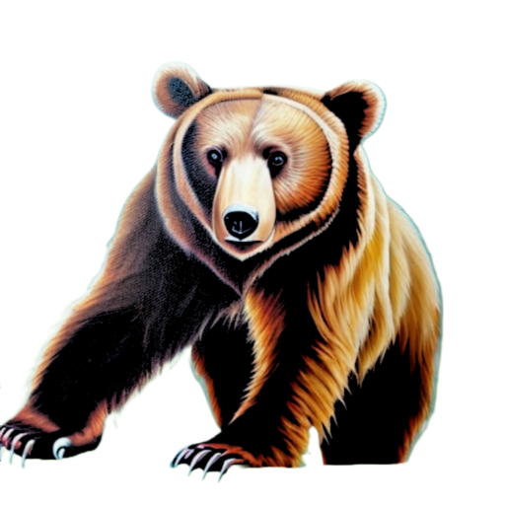
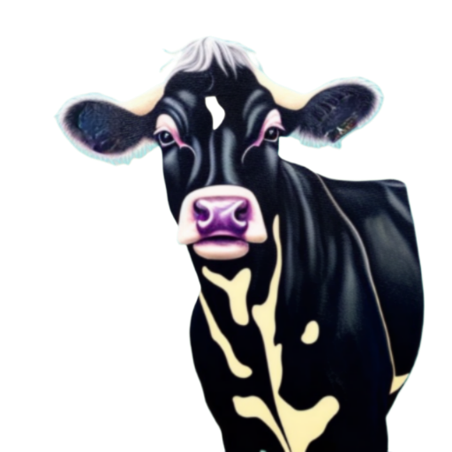
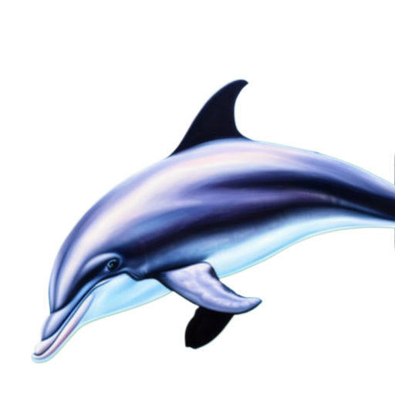
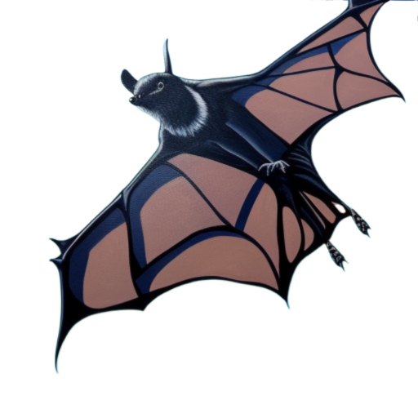
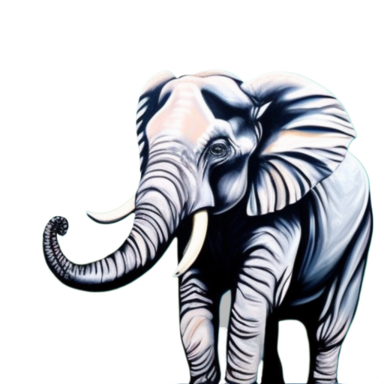
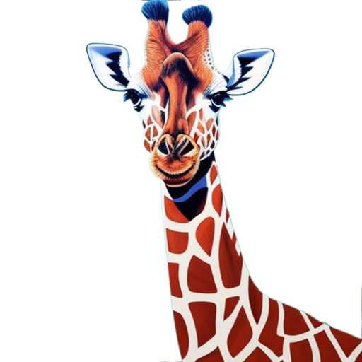
COW
BEAR
MAMMAL
MAMMAL
Makes Milk Legs
Flying Fins
Tail Feathers
Makes Milk Legs
Flying Fins
Tail Feathers
DOLPHIN
BAT
MAMMAL
MAMMAL
Makes Milk Legs
Flying Fins
Tail Feathers
Makes Milk Legs
Flying Fins
Tail Feathers
ELEPHANT
GIRAFFE
MAMMAL
MAMMAL
Makes Milk Legs
Flying Fins
Tail Feathers
Makes Milk Legs
Flying Fins
Tail Feathers

Slide 2
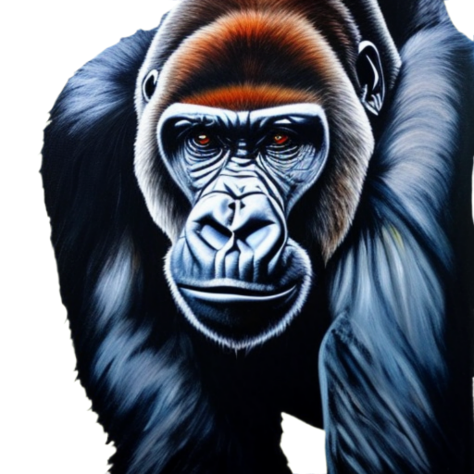
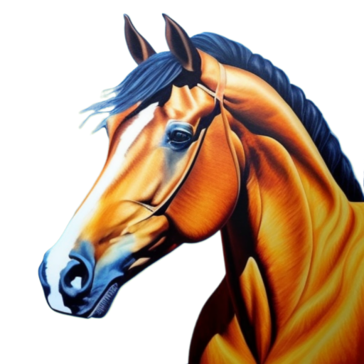
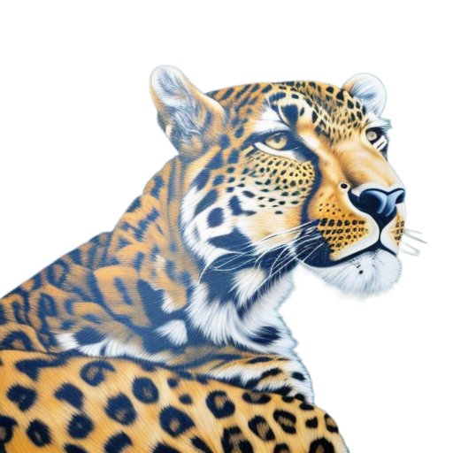
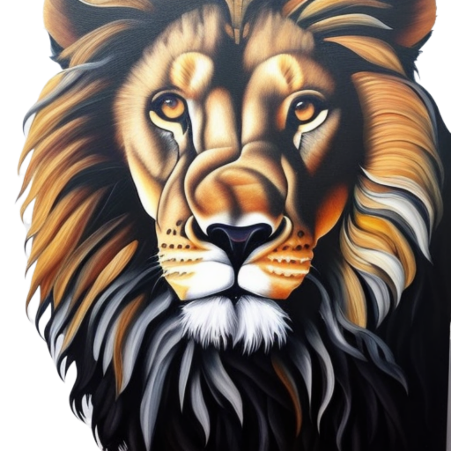
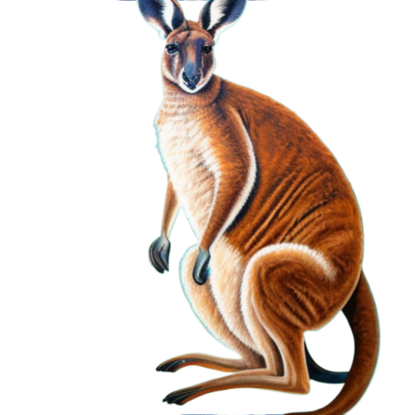
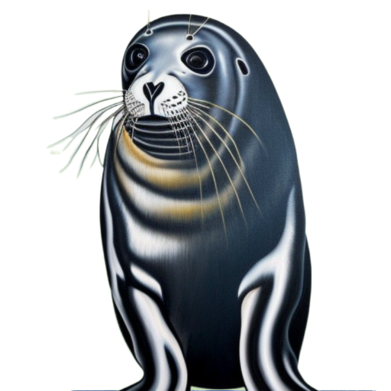
GORILLA
HORSE
MAMMAL
MAMMAL
Makes Milk Legs
Flying Fins
Tail Feathers
Makes Milk Legs
Flying Fins
Tail Feathers
LEOPARD
LION
MAMMAL
MAMMAL
Makes Milk Legs
Flying Fins
Tail Feathers
Makes Milk Legs
Flying Fins
Tail Feathers
KANGAROO
SEAL
MAMMAL
MAMMAL
Makes Milk Legs
Flying Fins
Tail Feathers
Makes Milk Legs
Flying Fins
Tail Feathers

Slide 3
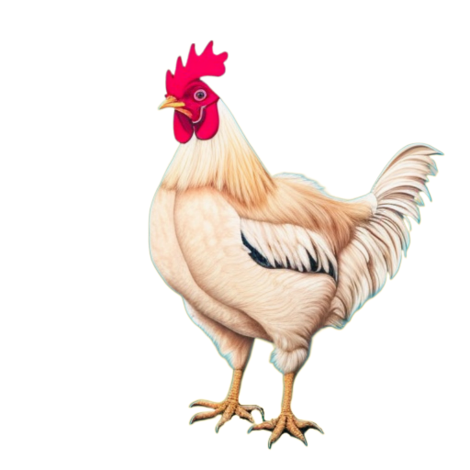
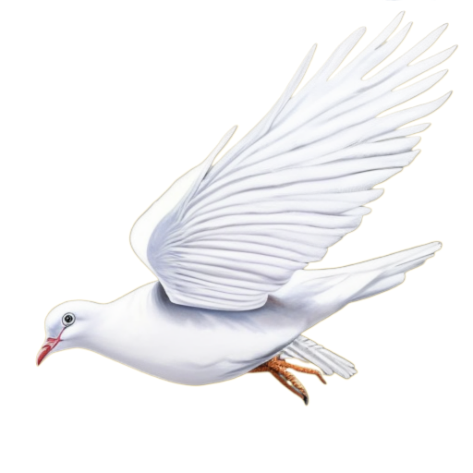
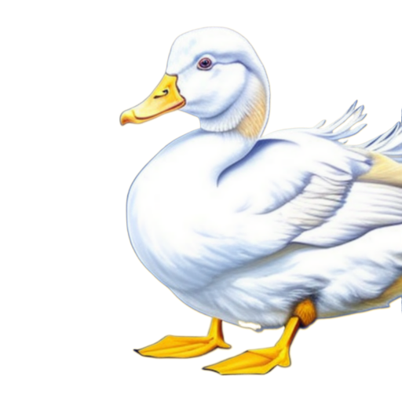
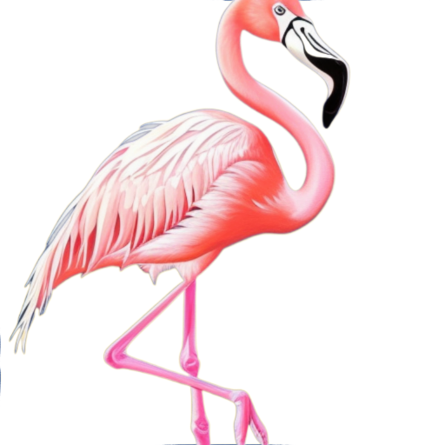
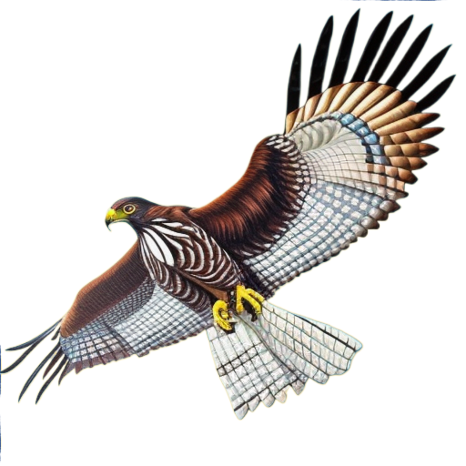
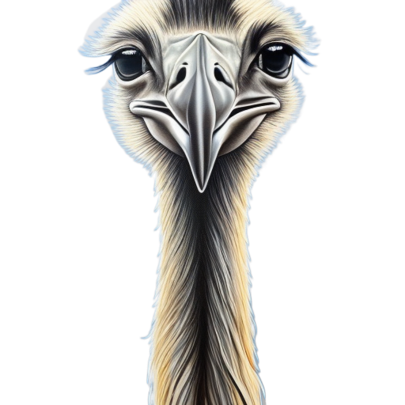
CHICKEN
DOVE
BIRD
BIRD
Makes Milk Legs
Flying Fins
Tail Feathers
Makes Milk Legs
Flying Fins
Tail Feathers
DUCK
FLAMINGO
BIRD
BIRD
Makes Milk Legs
Flying Fins
Tail Feathers
Makes Milk Legs
Flying Fins
Tail Feathers
HAWK
OSTRICH
BIRD
BIRD
Makes Milk Legs
Flying Fins
Tail Feathers
Makes Milk Legs
Flying Fins
Tail Feathers

Slide 4
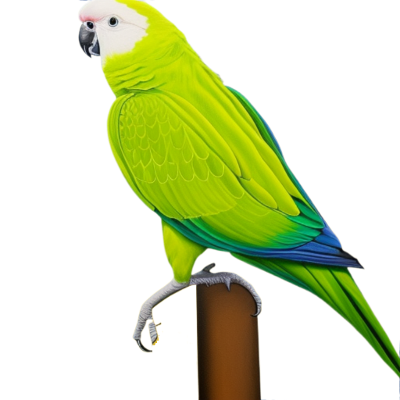
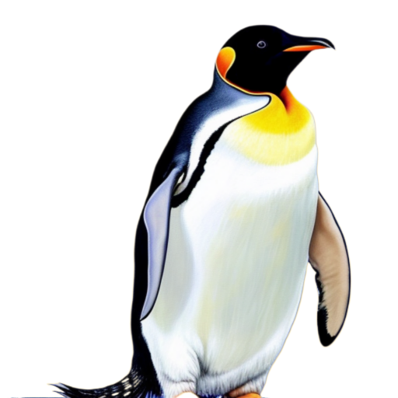
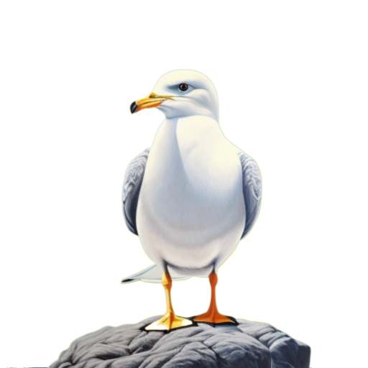
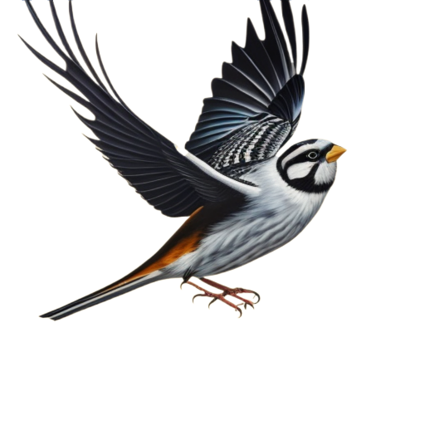
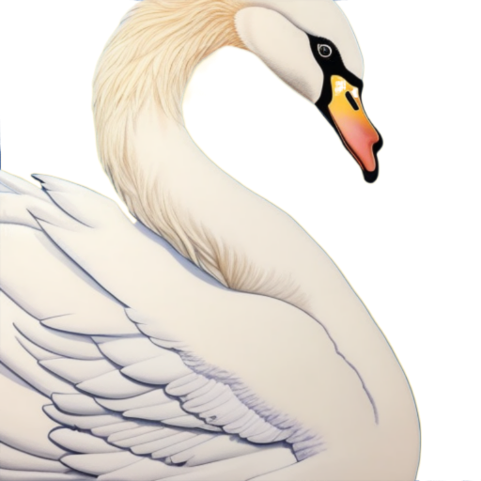
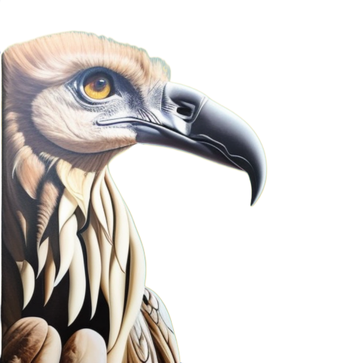
PARAKEET
PENGUIN
BIRD
BIRD
Makes Milk Legs
Flying Fins
Tail Feathers
Makes Milk Legs
Flying Fins
Tail Feathers
SEAGULL
SPARROW
BIRD
BIRD
Makes Milk Legs
Flying Fins
Tail Feathers
Makes Milk Legs
Flying Fins
Tail Feathers
SWAN
VULTURE
BIRD
BIRD
Makes Milk Legs
Flying Fins
Tail Feathers
Makes Milk Legs
Flying Fins
Tail Feathers

Slide 5
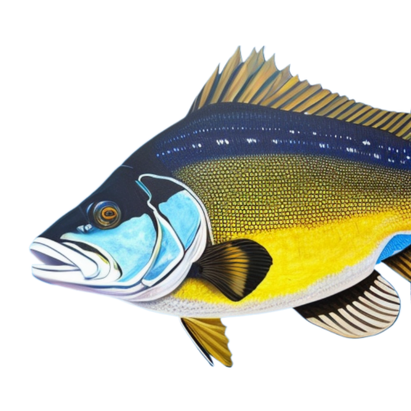
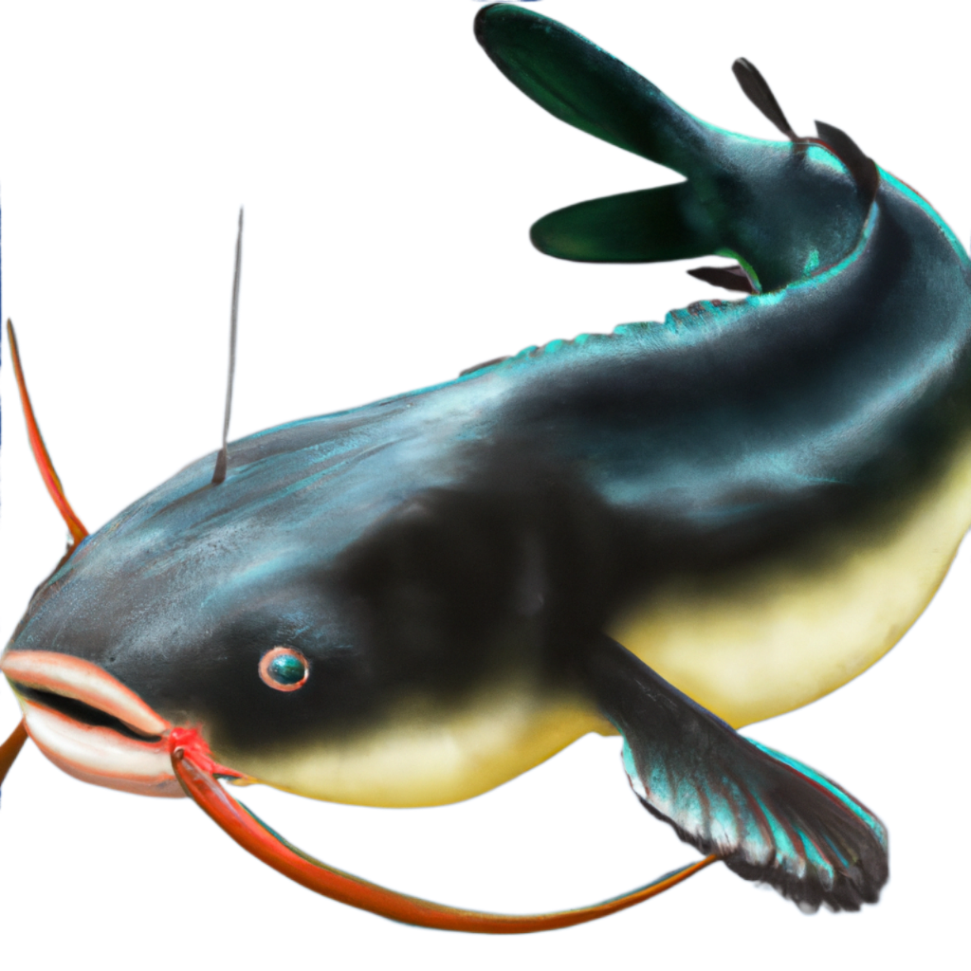
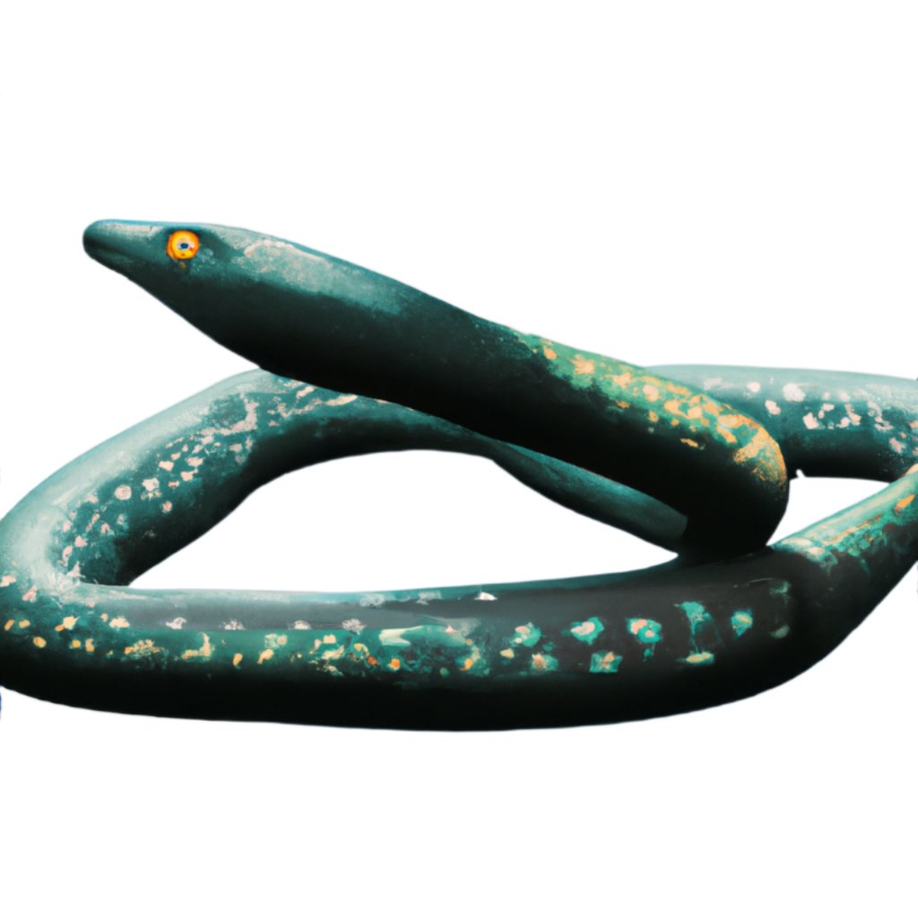
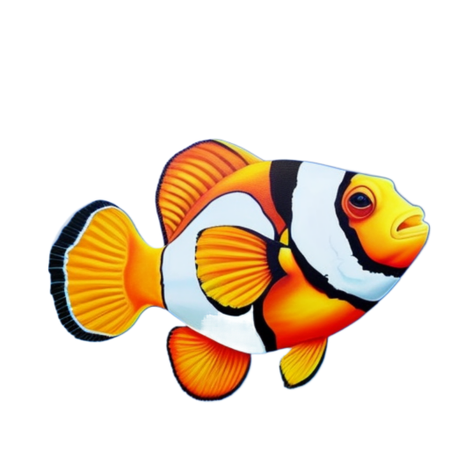
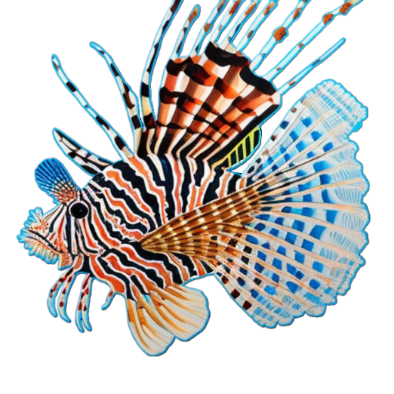
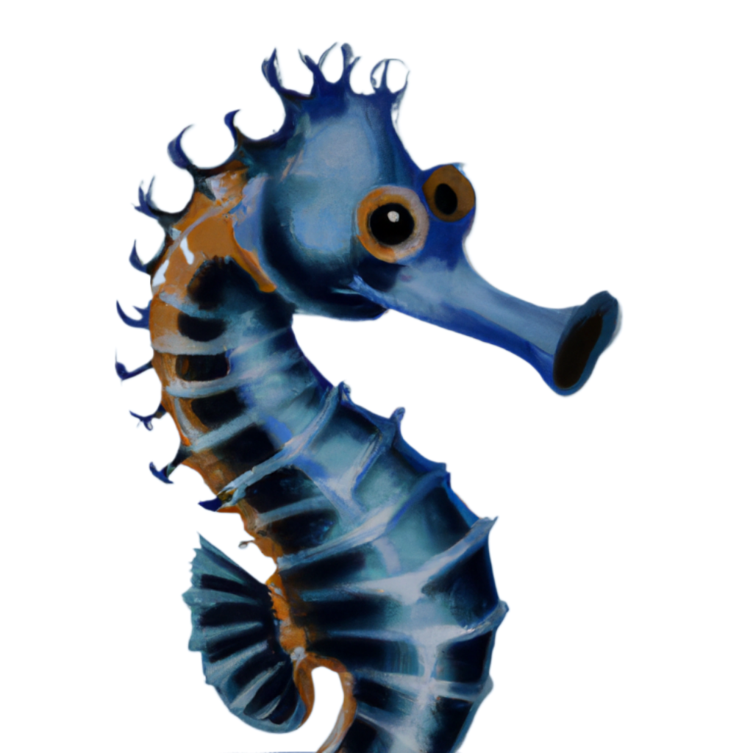
BASS
CATFISH
FISH
FISH
Makes Milk Legs
Flying Fins
Tail Feathers
Makes Milk Legs
Flying Fins
Tail Feathers
EEL
CLOWNFISH
FISH
FISH
Makes Milk Legs
Flying Fins
Tail Feathers
Makes Milk Legs
Flying Fins
Tail Feathers
LIONFISH
SEAHORSE
FISH
FISH
Makes Milk Legs
Flying Fins
Tail Feathers
Makes Milk Legs
Flying Fins
Tail Feathers

Slide 8
MAKES MILK
MAKES MILK
MAKES MILK
MAKES MILK
FLYING
FLYING
FLYING
FLYING
TAIL
TAIL
TAIL
TAIL
LEGS
LEGS
LEGS
LEGS
FINS
FINS
FINS
FINS
FEATHERS
FEATHERS
FEATHERS
FEATHERS

